Slide 1
Market Analysis and Consumer Insights for Mobile Phones
### Key Insights
Market Segmentation: Mid-Range Segment (41.71%) dominates, followed by Budget Segment (29.58%).
Brand Performance: Samsung leads with 206 models; OPPO and realme follow.
Consumer Preferences: Popular configurations are 4GB RAM + 64GB Storage (16.43%) and 3GB RAM + 32GB Storage (17.29%).
### Conclusion
The market is price-sensitive, with weak correlation between price and quality perception.

Slide 2
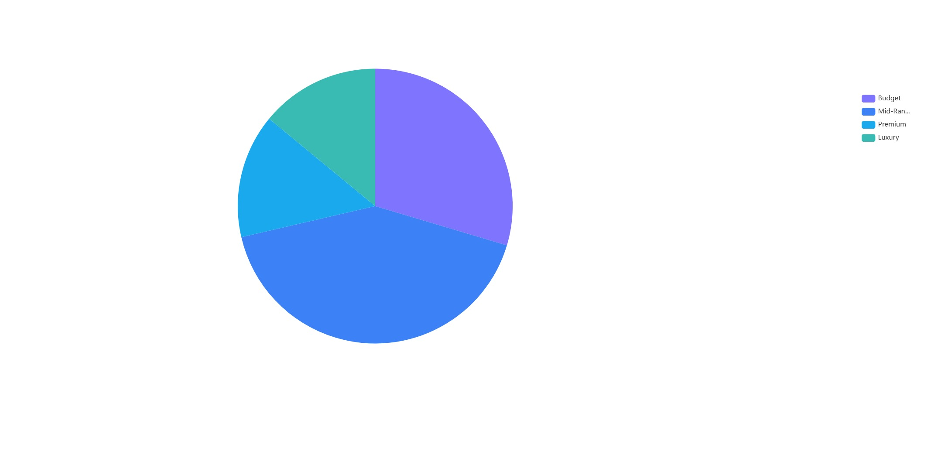

Slide 3
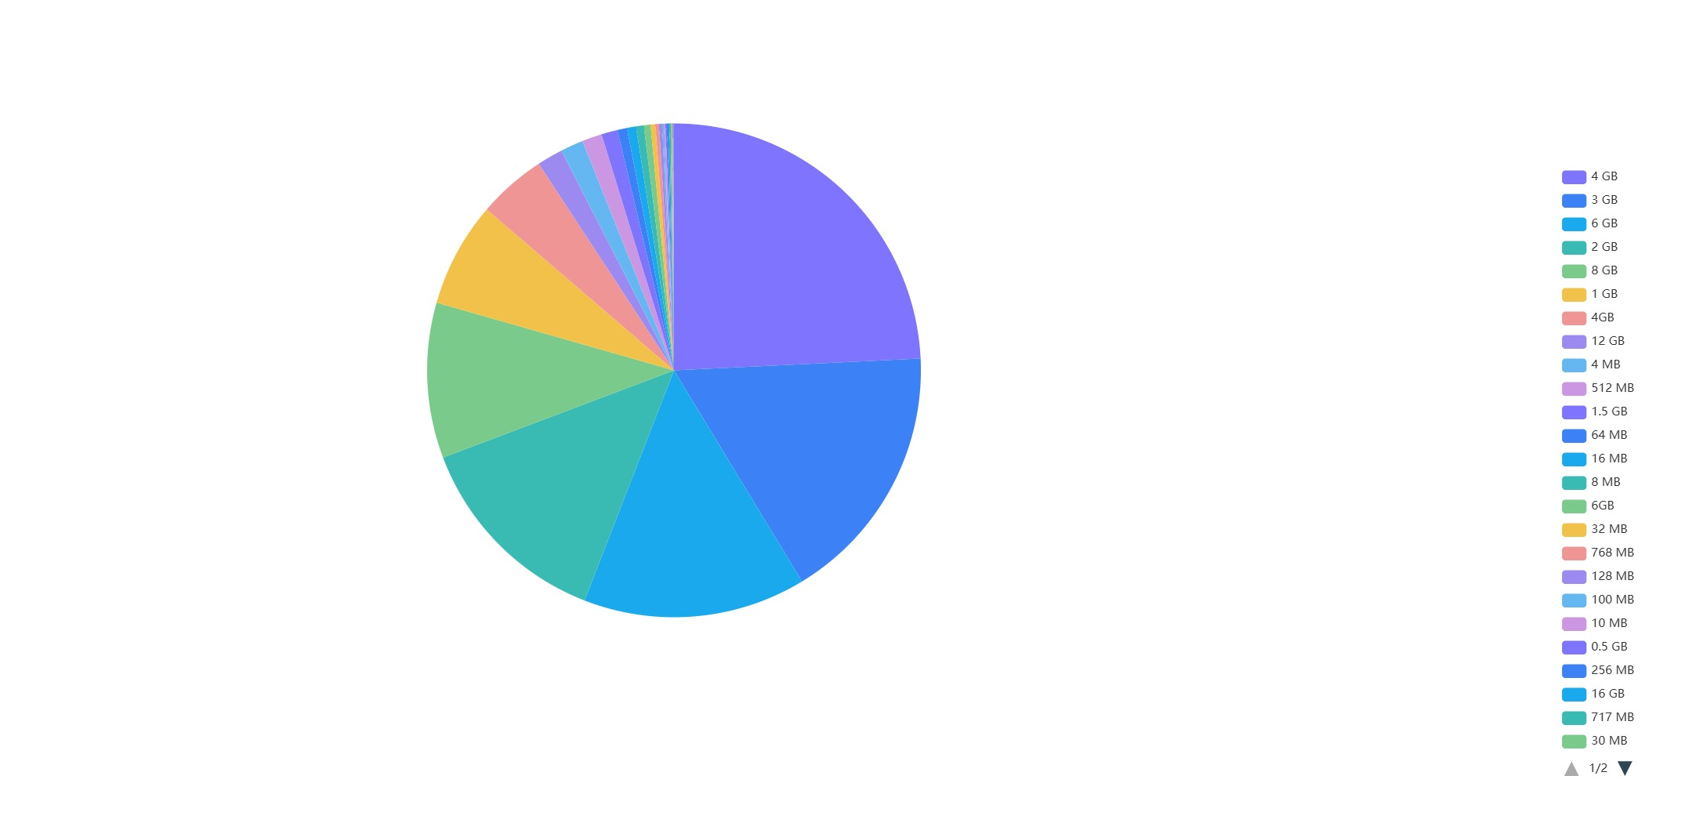

Slide 4
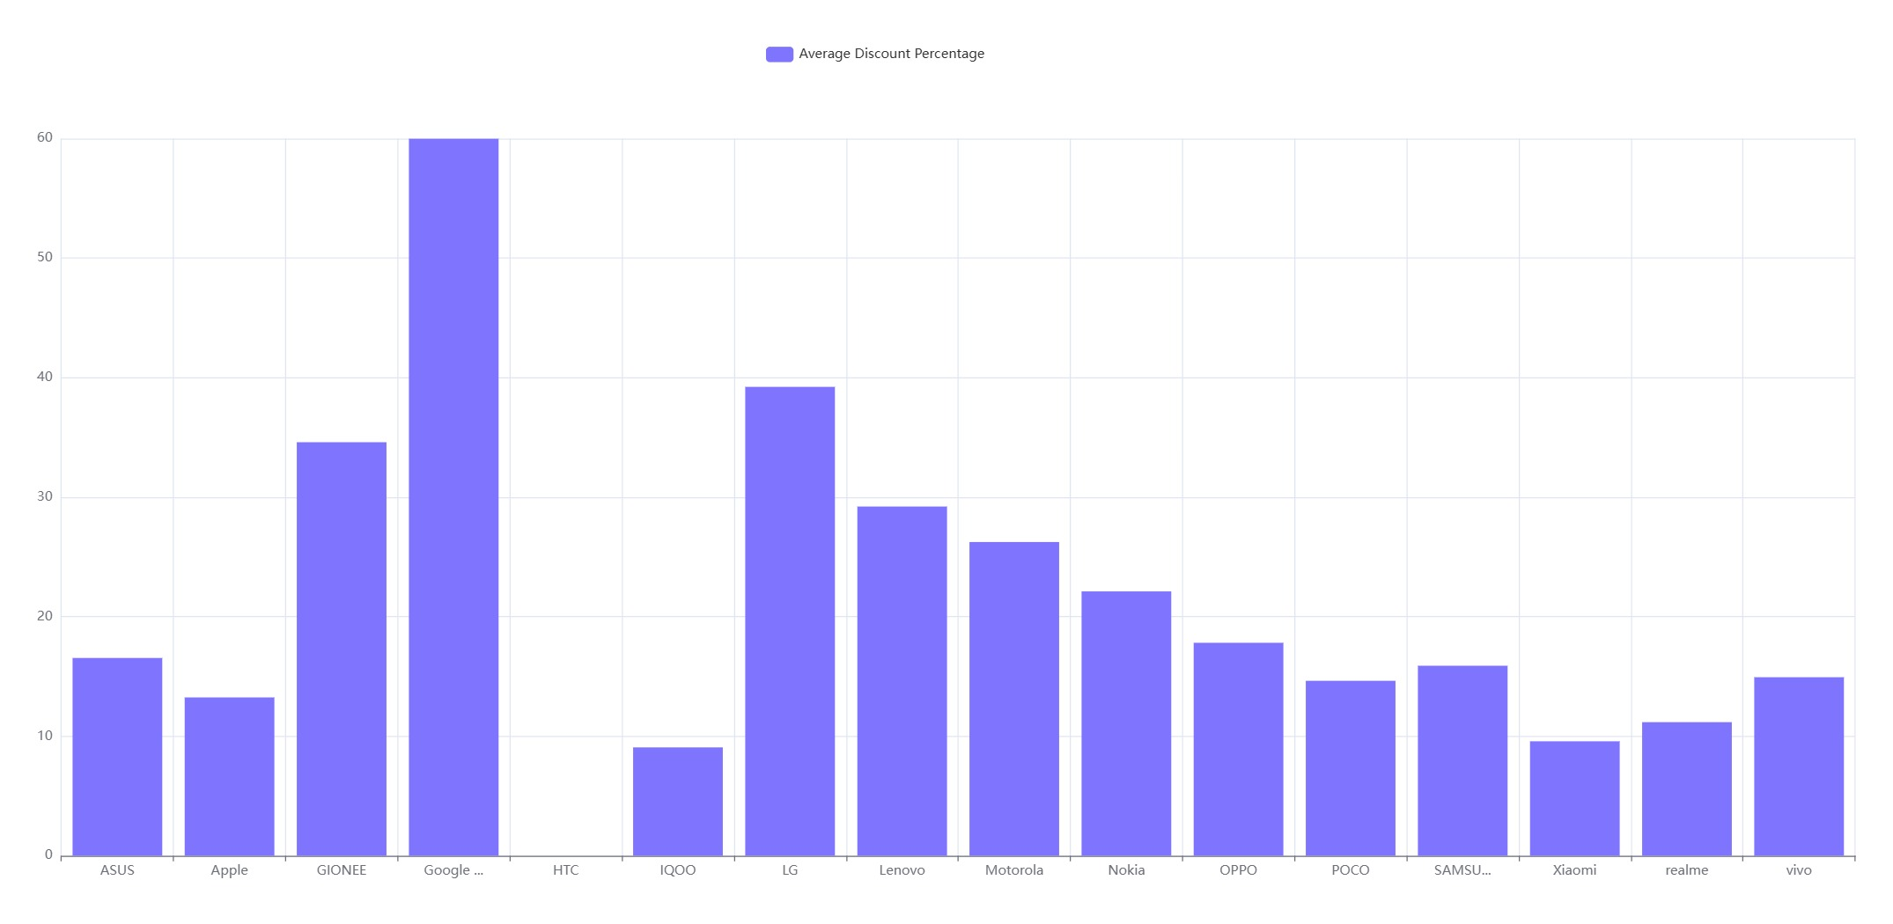

Slide 5
